Slide 1
STUDENTS DETAILS TEAM ID: LTVIP2023TMID06483 MAHASEN PODILI TEJASWINI SIRASANI SRAVANI
COLLEGE NAME: Malineni Lakshmaiah Womens Engineering College
COLLEGE STATE: Andhra Pradesh
INTERNSHIP DOMAIN: Front-End Development
PROJECT TITLE: Personal Technical Weather App application

Slide 2
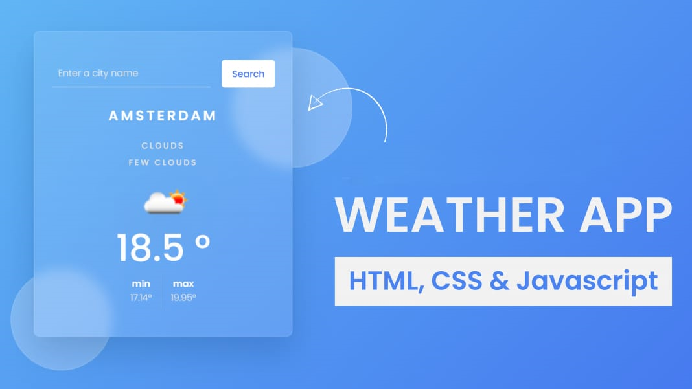

Slide 3
AGENDA
The agenda for a weather app typically involves providing users with accurate and relevant weather information to help them plan their activities and make informed decisions based on the forecast.
The app should provide real-time weather updates, including current temperature, humidity, wind speed, and atmospheric pressure. This data helps users understand the cur rent weather conditions.

Slide 4
PROJECT OVERVIEW
Developing a comprehensive weather forecasting application that provides users with real-time and accurate weather information, forecasts, and alerts to help them make informed decisions and plan their activities based on current and upcoming weather conditions.
The Weather Forecasting Application aims to provide users with an efficient, user-friendly, and feature-rich tool for accessing accurate weather forecasts, making informed decisions, and staying updated about meteorological conditions.

Slide 5
WHO ARE PROJECT END USER ?
The end users for a weather app project can be quite diverse, as weather information is relevant and valuable to a wide range of individuals and groups. Here are some of the key end user groups for a weather app:
General Public, Travelers, Outdoor Enthusiasts, Pilots and Aviators, Farmers and Agriculturists, Construction Workers, etc.

Slide 6
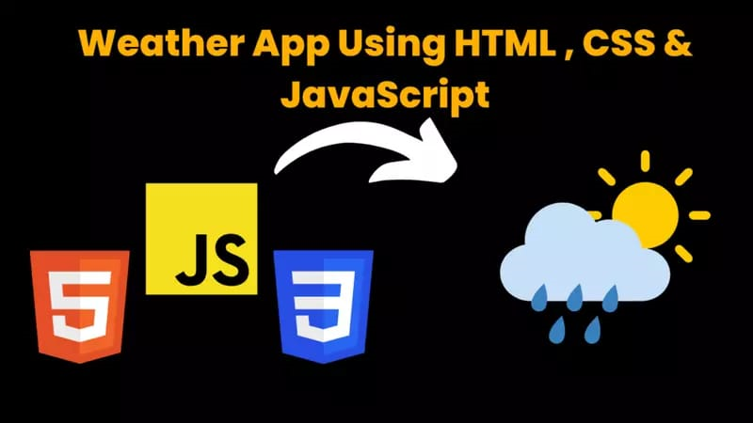
BUILDING WEATHER APPLICATION

Slide 7
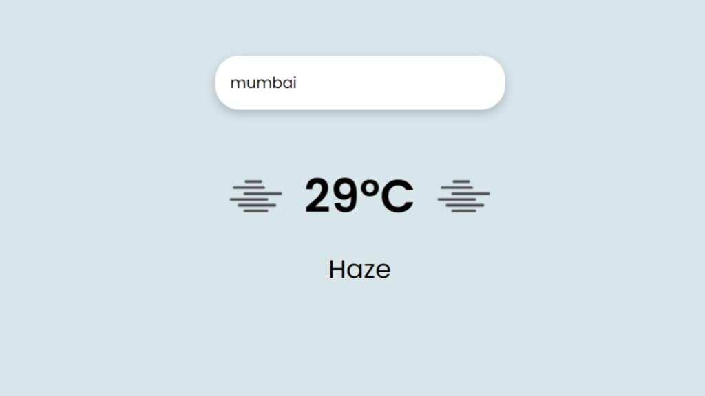
HTML
HTML (Hypertext Markup Language) is used for structuring and organizing the content of a web page, including weather apps.
HTML provides a structured way to define the elements and components of a weather app's user interface. It allows you to create headings, paragraphs, lists, tables, forms, and other content elements that help organize and present weather-related information.
HTML is essential for creating the foundation of a weather app's user interface, structuring the content, and defining the layout of different elements. It allows you to present weather-related information in a clear, organized, and accessible manner while providing a basis for interactivity and integration with styling and scripting technologies like CSS and JavaScript.

Slide 8
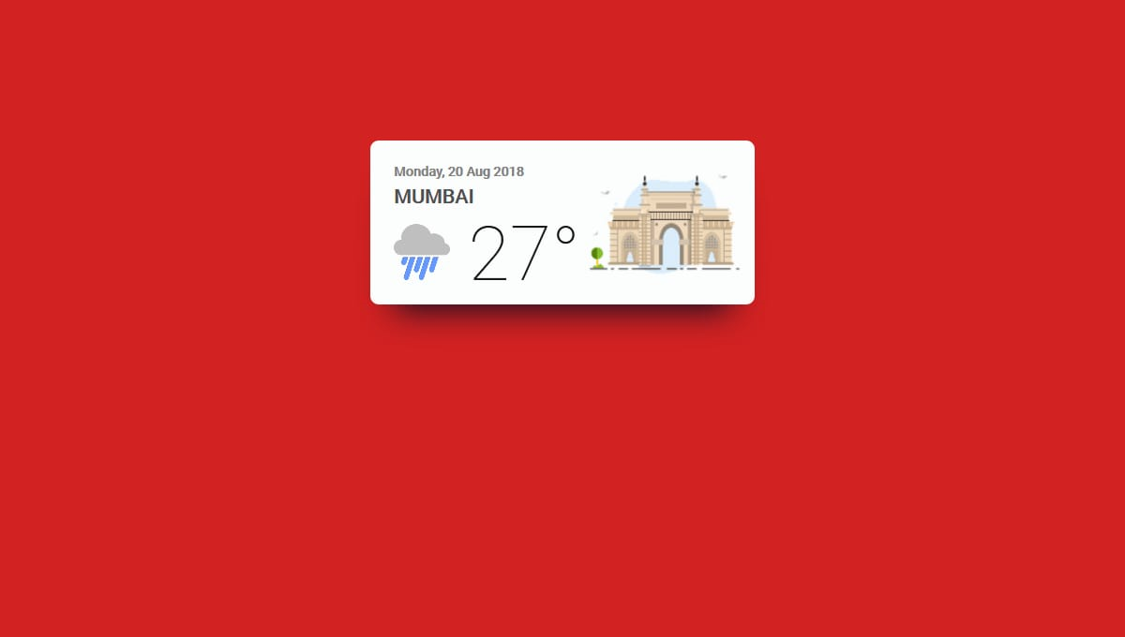
CSS
CSS (Cascading Style Sheets) is used for styling and visually formatting web applications.
CSS allows you to create visually appealing and engaging user interfaces for your weather app. It helps in designing layouts, color schemes, typography, and other visual elements that enhance the user experience and make the app more attractive and intuitive to use.
CSS plays a crucial role in creating an attractive, functional, and user-friendly weather app by controlling its visual presentation, layout, responsiveness, and user interactions. It allows developers to design and customize the app's appearance while keeping the code maintainable and adaptable.

Slide 9
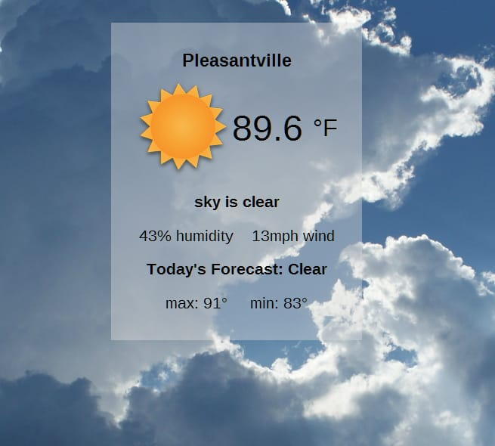
JAVASCRIPT
Weather apps often need to provide real-time updates and interactivity to users. JavaScript, as a client-side scripting language, allows developers to create dynamic and responsive user interfaces without needing to constantly refresh the entire page.
JavaScript enables the creation of interactive and visually appealing user interfaces. You can use it to create interactive maps, charts, animations, and other visual elements that enhance the user experience of a weather app.
JavaScript has a vast ecosystem of tools, libraries, and resources available, along with a large and active developer community. This makes it easier to find solutions to common challenges, troubleshoot issues, and stay up-to-date with best practices for building weather apps.

Slide 10
FEATURES
A weather app developed using HTML, CSS, and JavaScript can offer a range of features to provide users with accurate and engaging weather information. Here are some key features that you could include in such an app:
Current Weather Display:
Display the current temperature, weather condition (sunny, cloudy, rainy, etc.), and an icon representing the weather.
Show additional information like humidity, wind speed, and visibility.
Location Search:
Allow users to search for weather information in different locations by entering city names, postal codes, or coordinates.
Forecast Information:
Provide a multi-day forecast that includes high and low temperatures, weather conditions, and icons for each day.
Interactive Map:
Users can click on markers to view weather information for specific locations.
Weather Alerts:
Provide alerts or notifications for severe weather conditions, such as thunderstorms, hurricanes, or heavy snowfall.

Slide 11
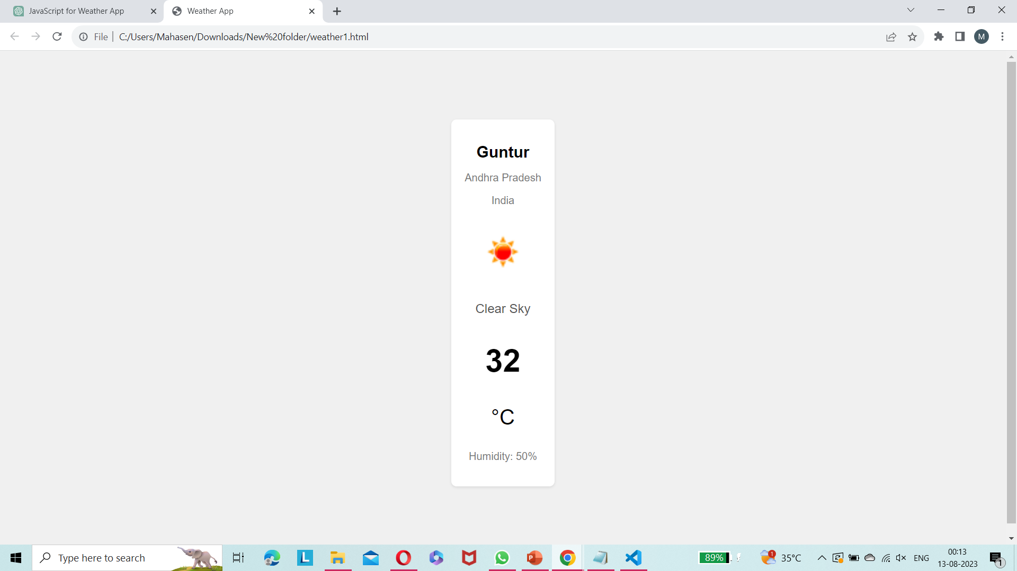
RESULTS

Slide 12


